Slide 1
INTTERACTIVE WEP PAGES

Slide 2
What will get?
Making web pages interactive
How to make website dynamic

Slide 3
Requirements
HTML and CSS
Basics of JavaScript coding
Desire to learn JavaScript
Fundamental JavaScript

Slide 4
How JavaScript can be used to apply interaction and dynamic content to web pages.

Slide 5
Create new element, updates elements and manipulate elements directly using JavaScript. Explore how easy it is to make your website come to life. Using the DOM Document Object Model connect to the elements via JavaScript.

Slide 6
Explore how JS can be added to web pages
Find out more about DOM Document Object Model
how to create elements using JavaScript and add them to a webpage
Create interaction using event listeners in JavaScript

Slide 7
JavaScript HTML DOM EventListener
Add an event listener that fires when a user clicks a button:
SYNTAX:
element.addEventListener(event, function, useCapture);
document.getElementById("myBtn").addEventListener("click", displayDate);

Slide 8
EXAMPLE

Slide 9
The addEventListener() method attaches an event handler to the specified element.
The addEventListener() method attaches an event handler to an element without overwriting existing event handlers.
You can add many event handlers to one element.

Slide 10
Add an Event Handler to an Element
Alert "Hello World!" when the user clicks on an element:
SYNTAX:
element.addEventListener("click", function(){ alert("Hello World!"); });

Slide 11
EXAMPLE

Slide 12
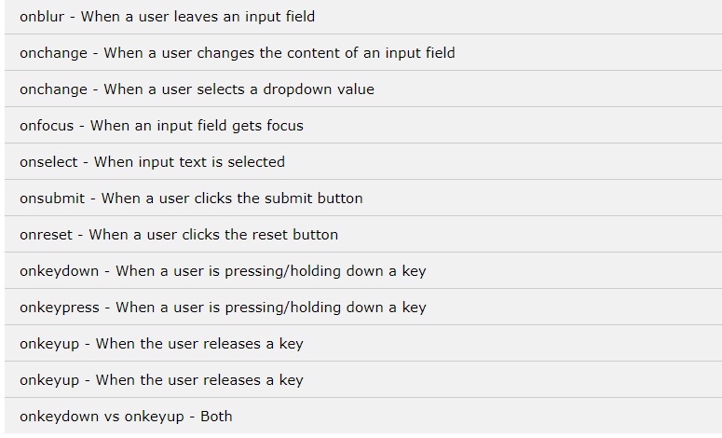
JavaScript HTML DOM Events Examples

